Slide 1
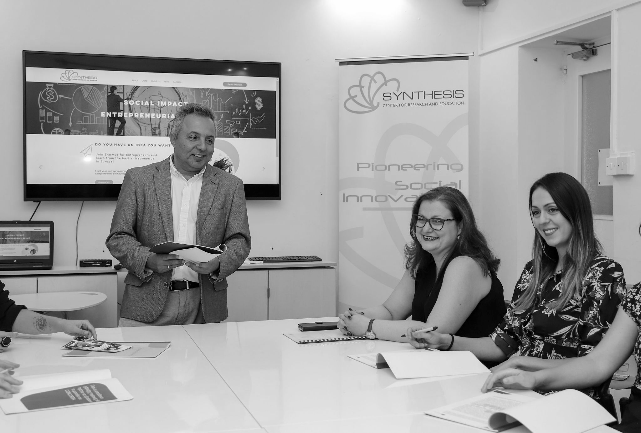
Brief presentation

Slide 2
Why
“SYNTHESIS”
Synthesis refers to the ABILITY to put parts TOGETHER to form a NEW WHOLE. In Hegelian philosophy, ‘synthesis’ is the NEW idea which RESOLVES the CONFLICT between thesis and antithesis.
Our PASSION is the CREATION of NEW ideas and forms and their REALISATION in education, business and society for the good of the PEOPLE and the PLANET.

Slide 3
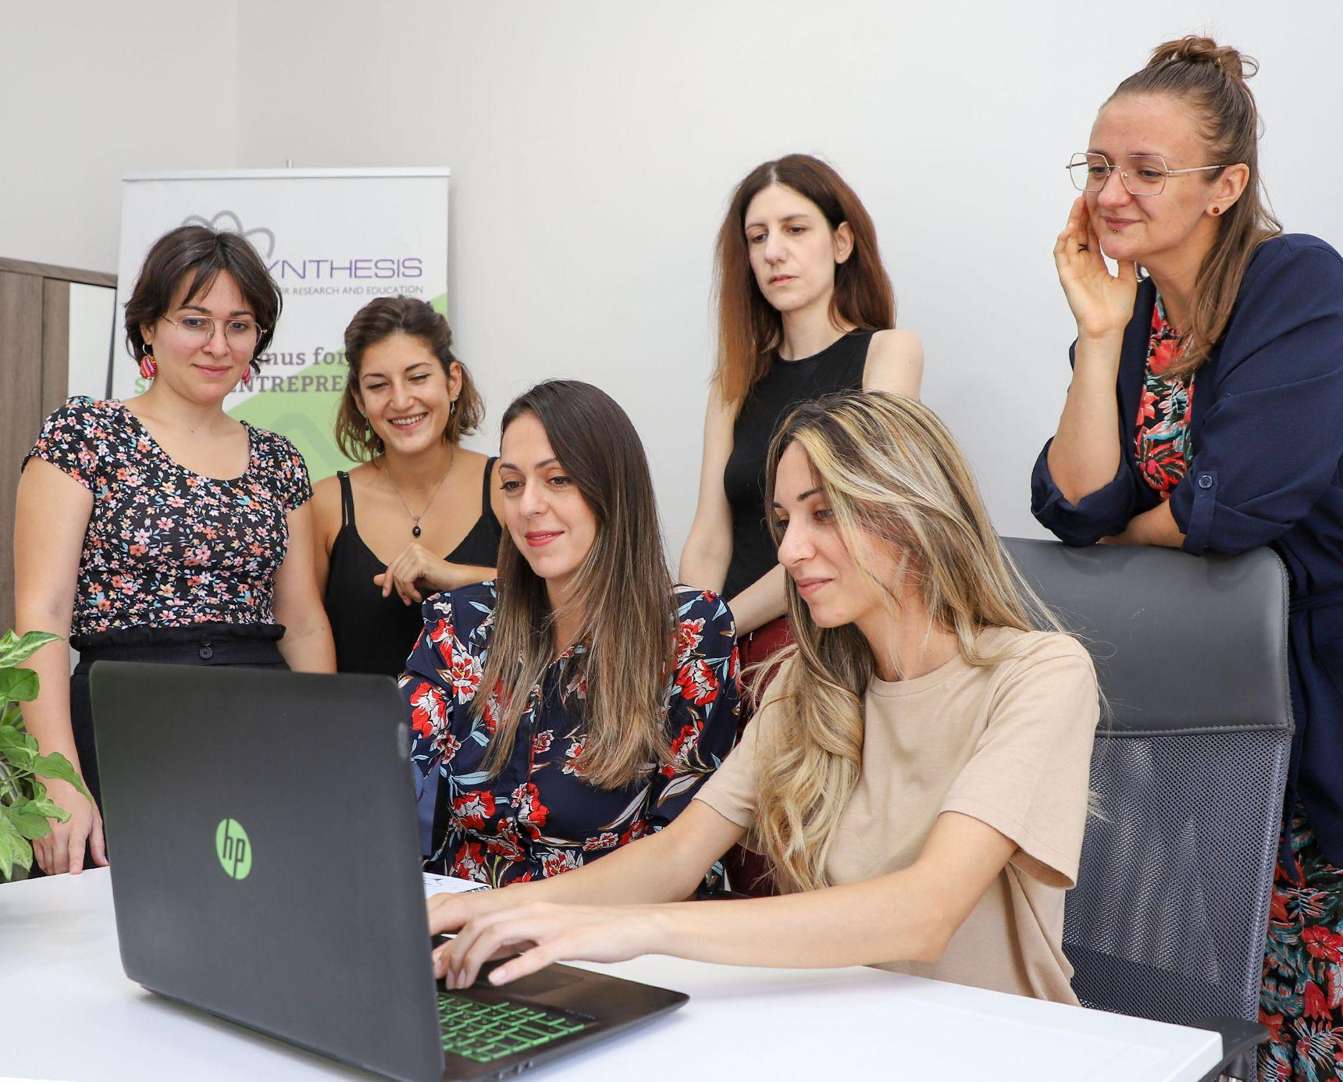
About us
SYNTHESIS is a pioneering organisation which initiates and implements projects of social impact, with a focus on social inclusion.

Slide 4
“Social impact can be defined as the net effect
of an activity/action on a community and the well-being of individuals and families.”
—Center for Social Impact (CSI)

Slide 5
Main focus areas
01
02
03
04
ENTREPRENEURSHIP INCLUDING SOCIAL ENTREPRENEURSHIP
EMPLOYABILITY - PROFESSIONAL DEVELOPMENT
SOCIAL INCLUSION AND MIGRANT INTEGRATION
ENVIRONMENTAL
SUSTAINABILITY

Slide 6
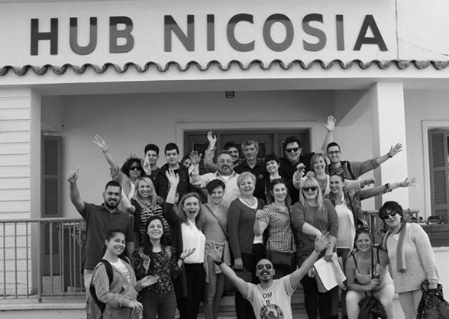
Milestones
PIONEER EVENTS
RESEARCH & POLICY
Organised the first conference and events on Social Entrepreneurship in Cyprus
“Policy document on developing the social enterprise ecosystem in Cyprus”
2002
2010
2015
2017
2019
FOUNDED
HUB NICOSIA
The leading organisation in the country in the fields of social entrepreneurship and social innovation
Founded "Hub Nicosia”,
a coworking space and educational center

Slide 7
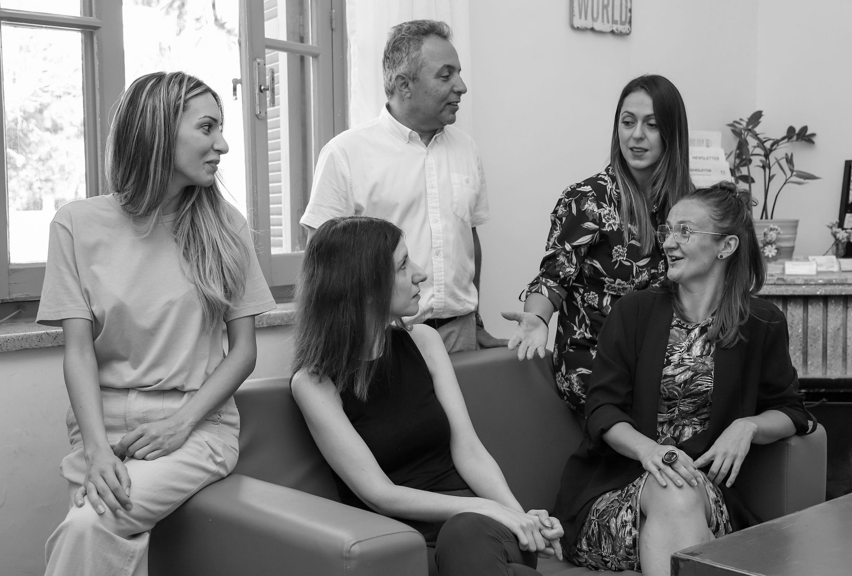
Recent progress
FUSE PROJECT
2019
MAPPING STUDY FOR THE EUROPEAN COMMISION
2021
National Competence Center for Social Innovation (ESF+ Network of Competence Centres for Social Innovation (ENCCSI)
“Social Enterprises and their Ecosystems in Europe: Cyprus“

Slide 8
Units
● VET and Adult Learning
● Youth learning
● School education
● Higher Education
● Migrant integration
● Prevention and Countering of Violent Extremism and Radicalisation

Slide 9
WHAT WE OFFER
CONSULTING
PRACTICE
IMPLEMENTATION
Experience is social inclusion & disadvantaged groups (migrants and refugees, NEET, youth, women, elderly etc).
Expertise in the field of social entrepreneurship & social innovation
Pilot and transfer best practices to Cyprus
RESEARCH
NETWORKING
MERCURY
TRAINING
Interdisciplinary scientific team
Long lasting and trustworthy National & European Cooperation
Development of training programs and curricula

Slide 10
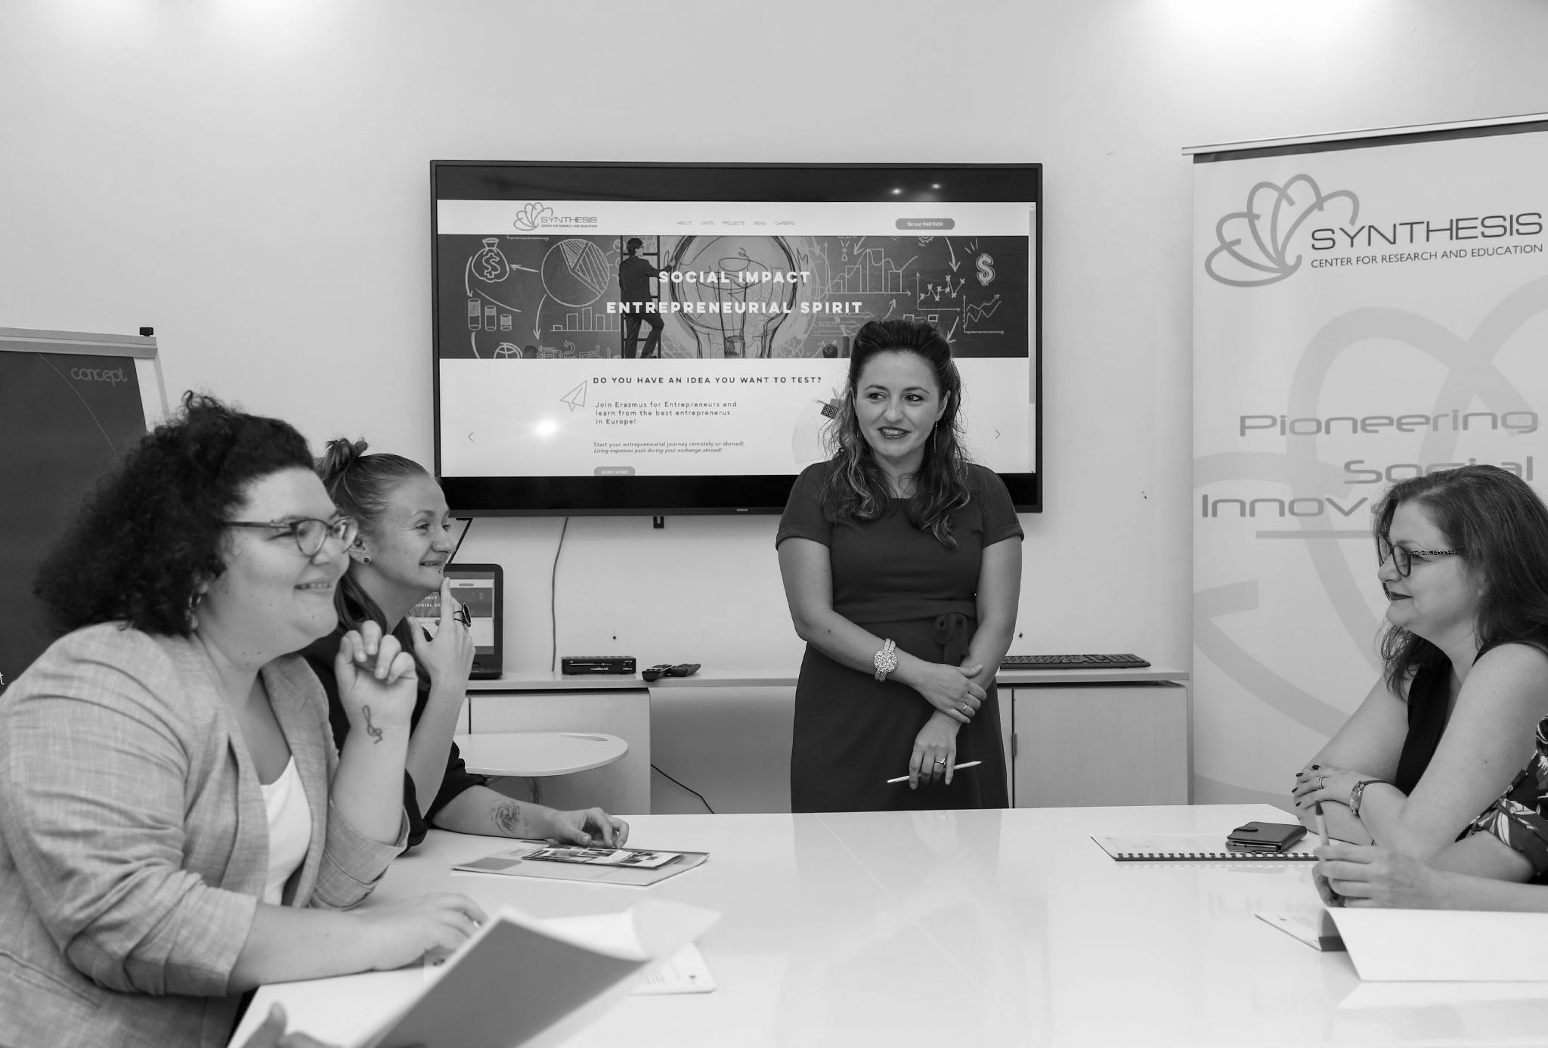
OUR PROJECTS
Browse through our list of projects in our website.

Slide 11
Thanks
isaias@synthesis-center.com
+357 22252315
https://www.synthesis-center.com/

